Slide 1
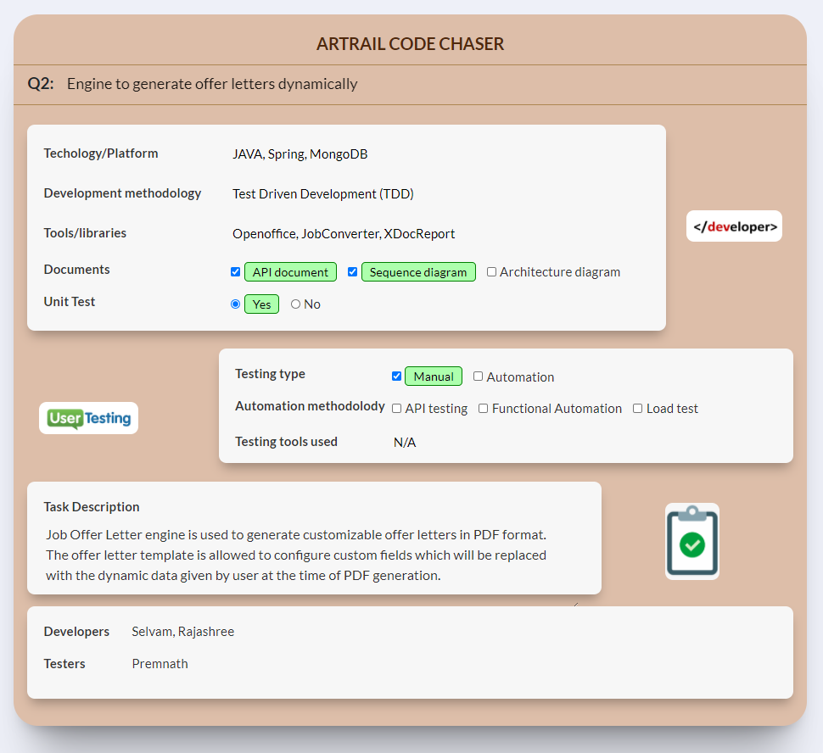

Slide 2
Highlights
Job offer letter engine will provide users to generate various template with dynamic data.
Instead of using dedicated apps like Crystal report, Fast report, etc., this is easily achievable through MS word.
The custom fields can be added anywhere in the document like title, table, header, footer and any position in the body section of Word document.
The Offer letter can be updated at any time and downloaded as PDF format.
The OpenOffice application is used for the DOCX to PDF conversion, thus the resultant document will be accurate and the content will be as same as in Word document.
The offer letter engine is testable without UI through APIs itself.

Slide 3
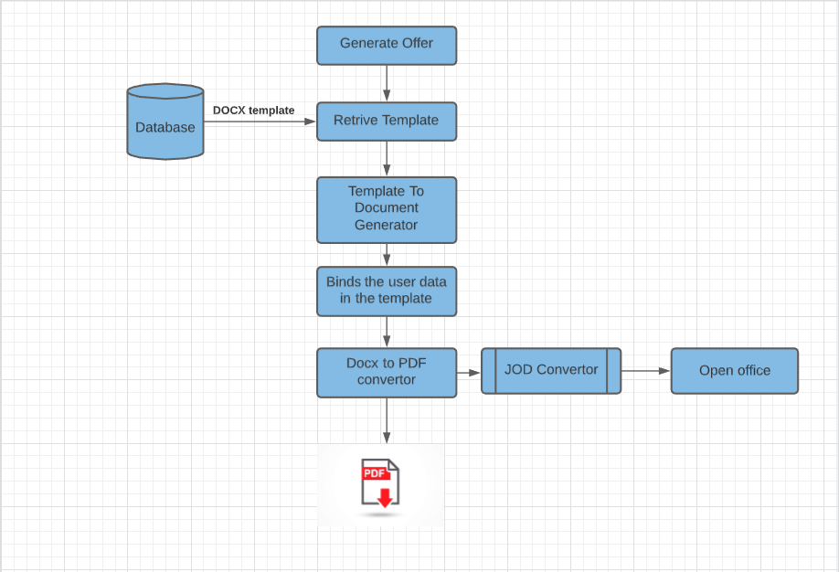
Process Flow Diagram

Slide 4
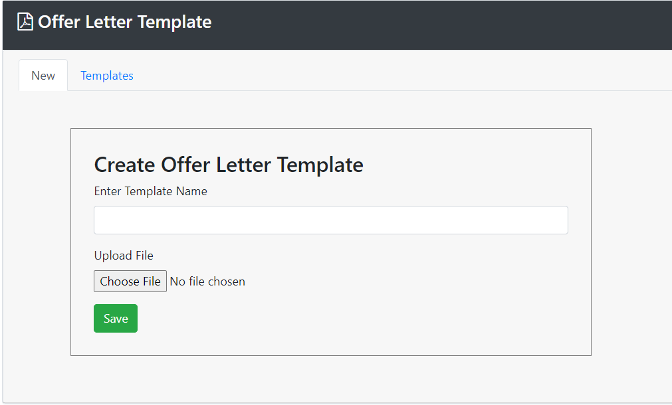
Create Offer Letter Template
Can create a Job Offer Letter template

Slide 5
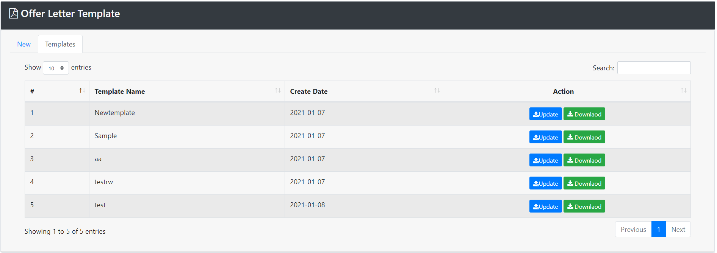
View Offer Letter Template
The Offer letter templates will be listed here

Slide 6
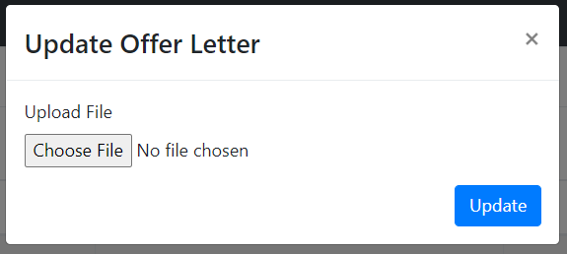
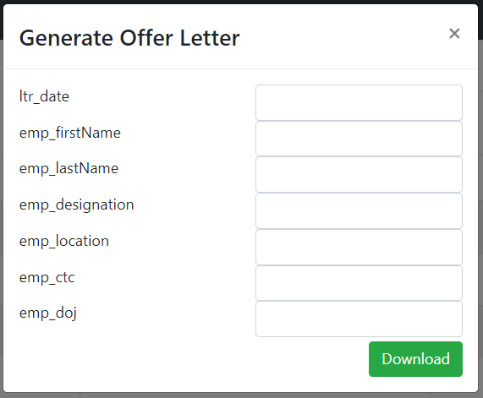
Update/Download Offer Letter Template
Update existing template
Download Offer Letter
Can able to update the Offer letter template
Offer letters can be downloaded as PDF format and while downloading a template user can provide data for the custom fields

Slide 7
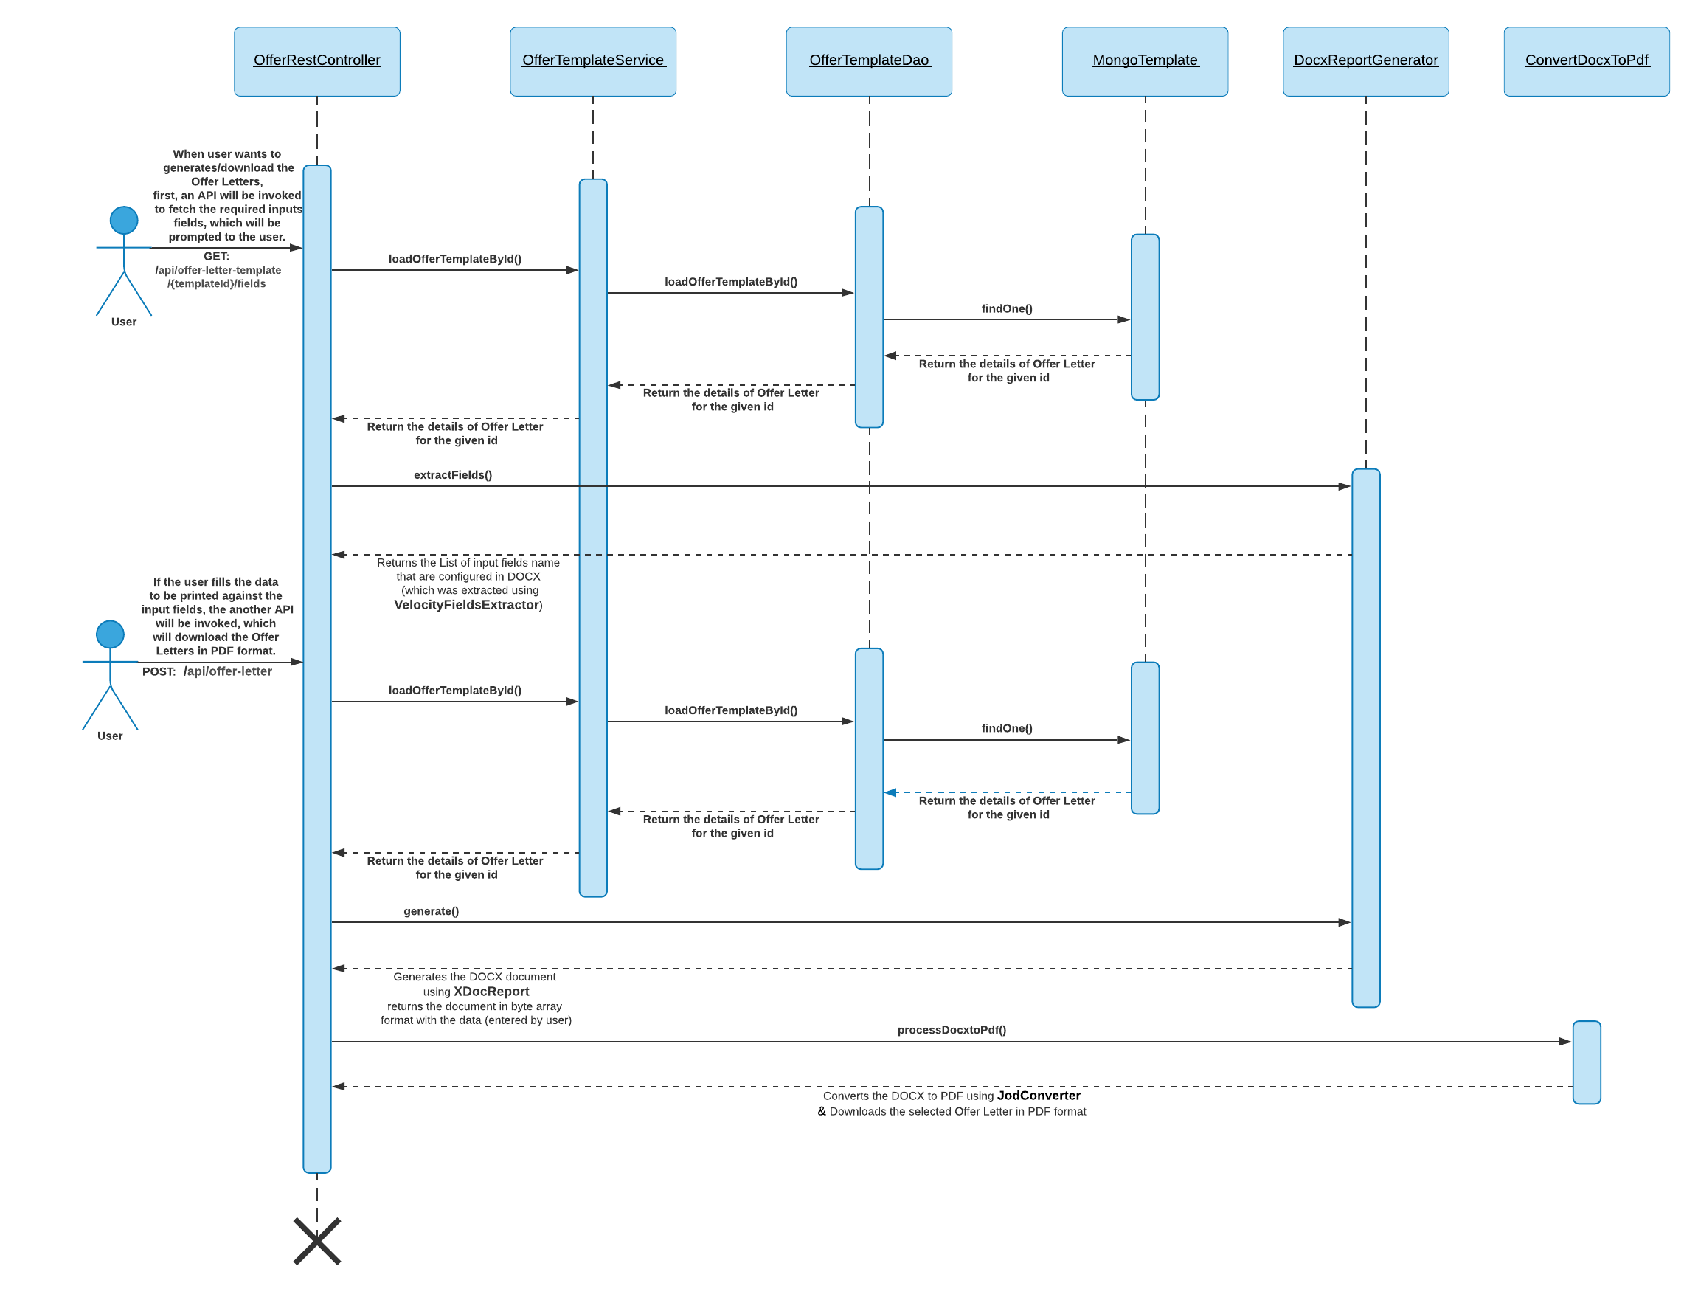
Job Offer Letter Generation Process

